Slide 1

FLOOD MONITORING AND ALERTING SYSTEM USING IOT
K S SCHOOL OF ENGINEERING & MANAGEMENT
BENGALURU-560109
DEPARTMENT OF ELECTRONICS AND COMMUNICATION ENGINEERING
PROJECT WORK (15ECP85)-PHASE 2
Presented By
1KG16EC085 SACHETH D S
1KG16EC089 SHAHID KHAN A
1KG16EC110 UDAY L
1KG16EC091 SHREYAS B R
Internal Guide
Mrs. Kripa K B,
Asst. Prof, ECE, KSSEM
Dept of ECE, KSSEM
01

Slide 2
CONTENTS
Introduction
Existing System and it’s disadvantages
Problem Statement
Literature Survey
Objectives
Final components
Design
Proposed System and it’s advantages
Conclusion
References
Dept of ECE, KSSEM
02

Slide 3
INTRODUCTION
A flood is an overflow of water that submerges land that is usually dry.
Experts defines a flood as a covering by water of land not normally covered by water.
In the sense of "flowing water", the word may also be applied to the inflow of the tide
Floods can be caused by a number of processes, but the dominant cause is rainfall.
Floods are a natural process, but mankind's activities affect flooding. Floods occur at irregular intervals and vary in size, area of extent, and duration
Dept of ECE, KSSEM
03

Slide 4
Cont…
Rapid and appropriate disaster evacuation is needed so that victims of natural disasters can be immediately evacuated and rescued,
In the evacuation process there are often obstacles, such as disconnection of telecommunications networks, poor weather conditions, difficulty in accessing victims of natural disasters.
The uneven distribution of the SAR team caused by no information on the location of the disaster victims and the level of damage caused by the natural disaster.
Dept of ECE, KSSEM
04

Slide 5
Existing System
Natural disasters are one of the things that cannot be predicted. Natural disasters can cause losses, both assets and objects can even take lives.
To reduce the number of losses, rapid evacuation handling from the Search and Rescue (SAR) team is needed to help victims of natural disasters.
But in fact, there are often obstacles in the evacuation process. Such obstacles are such as bad weather conditions, disconnection of telecommunications networks, difficulty access to the victims of natural disasters and the spread of SAR teams that are not evenly distributed throughout the disaster area.
Manual Rescue is the Major Disadvantage
Dept of ECE, KSSEM
05

Slide 6
Existing System Disadvantages
Requires Lot of Human Effort
Human life Risk is involved
Pre Disaster Prediction is not present
Drone based implementation , needs human to monitor the videos.
Dept of ECE, KSSEM
06

Slide 7
Problem Statement
Natural disasters are one of the things that cannot be predicted. Natural disasters can cause losses, both assets and objects can even take lives.
To reduce the number of losses, rapid evacuation handling from the Search and Rescue (SAR) team is needed to help victims of natural disasters.
But in fact, there are often obstacles in the evacuation process. Such obstacles are such as bad weather conditions, disconnection of telecommunications networks, difficulty access to the victims of natural disasters and the spread of SAR teams that are not evenly distributed throughout the disaster area.
Dept of ECE, KSSEM
07

Slide 8
LITERATURE REVIEW
SL no. | TITTLE | AUTHOR | ABSTRACT | RESULT
1. | Early Flood Detection and Monitoring System Based on Wireless Sensor Network | Uyioghosa B. Iyekekpolo, Francis E. Idachaba. | This paper focuses on providing early warnings to areas likely to be ravaged by flood events using Wireless Sensor Network (WSN). | The system was tested via simulation of different flood scenarios, and the outcome was efficient and accurate.
2. | Flood Prediction and Prevention through Wireless Sensor Networking | Indira Priyadarshinee, Kabita Sahoo, Chandrakant Mallick | WSN is preferred due to its cost effectiveness, faster transfer of data & accurate computation of required parameter for flood prediction & prevention. | In this paper a survey is done on flood prediction & prevention through wireless sensor network.
Dept of ECE, KSSEM
08

Slide 9
sl no. | TITTLE | AUTHOR | ABSTRACT | RESULT
3. | An Early Flood Detection System Using Mobile Networks | Hung Ngoc Do, Minh-Thanh Vo, Van-Su Tran. | early ﬂood warning station powered by solar energy, a monitoring centre, and a notiﬁcation system. | The warning levels of ﬂood can be set up easily by using the buttons in the circuit board or by using the SMS message from user’s mobile phone.
4. | Early Flood Monitoring System using IOT Application | S Vara Kumari, O Sailaja, N V S Rama Krishna, | speak application for storing and retrieving data from the systems using the HTTP protocol over Local Area Network. | Thing speak stores data in private channel and share data among the public by using the public channel
5. | A Real Time Solution to Flood Monitoring System | Sonali Patil, Jija Pisal, Aishwarya Patil,Siddhi Ingavale. | places that are more prone to flooding are implemented of flood alert systems. | this system to inform the people about the upcoming flood through notification and alert messages
Dept of ECE, KSSEM
09

Slide 10
sl no. | TITTLE | AUTHOR | ABSTRACT | RESULT
6. | Flood Detection using Sensor Network and Notification via SMS and Public Network | Mohamed Ibrahim Khalaf alfahadiwy, Azizah suliman | Determines the current water level by means of sensors and by using wireless sensor network will then provide notification via GSM modem. | The architecture of the system can be expanded further to a fully functioning system in alerting the public of an impending disaster caused by flood.
7. | A Portable Flood Detection System Using Heterogeneous Sensor Network | Yanwei Wu and Yun Wang | It is necessary to design and deploy a portable intelligent system to monitor the danger and protect drivers’ safety. | By deploy sensors to roadside or to vehicles. The ﬂood alert will be sent to central control ofﬁce or vehicles accessing the network.
8. | Water Level Meter for Alerting Population about Floods | J. A. Hernandez-Nolasco, Miguel A. Wister, | designed a pilot project through a micro-model that is constructed with a water level measurement sensor. | the micro-model is tested by experimental tests under a controlled environment and satisfactory results are obtained.
Dept of ECE, KSSEM
10

Slide 11
OBJECTIVES
To detect the water level
Detect the water flow rate
Victim Detection
Dept of ECE, KSSEM
11

Slide 12
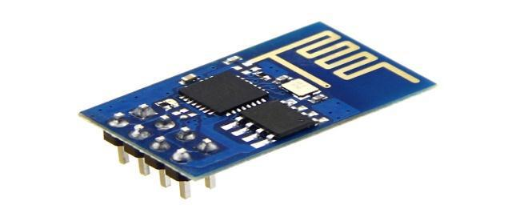
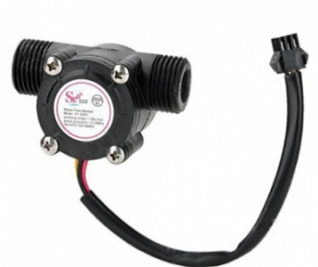
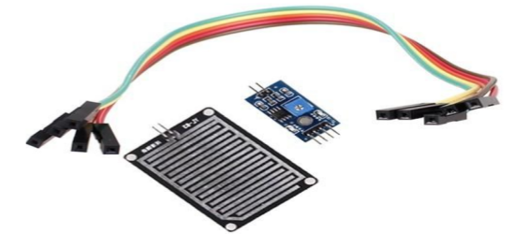
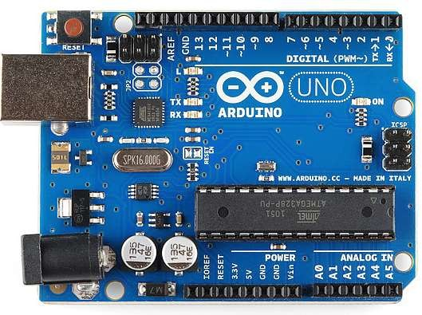

FINAL COMPONENTS
HARDWARE COMPONENTS
Aurdino.
Water flow sensor.
Ultra sonic level sensor.
Rain sensor.
WIFI ESR8266.
LCD Display
SOFTWARE COMPONENTS
Python, Embedded C
Dept of ECE, KSSEM
12

Slide 13
DESIGN
The design of the system is perhaps the most critical factor affecting the quality of the software. The objective of the design phase is to produce overall design of the software.
Design aims to figure out the modules that should be in the system to fulfil all the system requirements in efficient manner.
The design will contain the specification of all the modules, their interaction with other modules and the desired output from each module.
The output of the design process is a description of the software architecture.
Dept of ECE, KSSEM
13

Slide 14
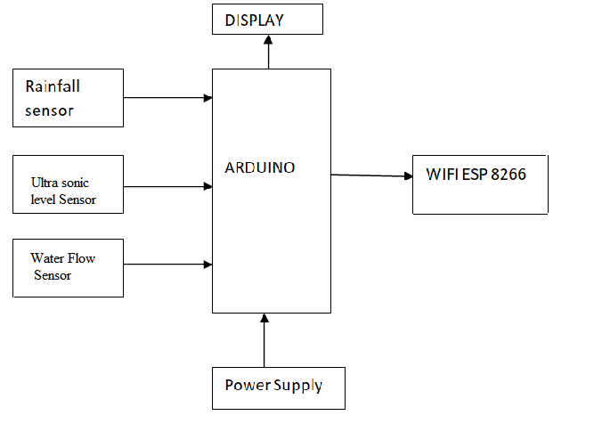
PROPOSED SYSTEM
Dept of ECE, KSSEM
14

Slide 15
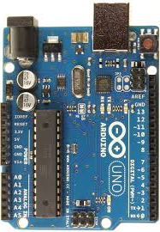
CIRCUIT DIAGRAM
S
+
-
5V
GND
ULTRA SONIC
LEVEL
SENSOR
BUZZER
WATER
FLOW
SENSOR
GND
TX
WIFI
ESP
8266
CH_PD
RX
RAIN
SENSOR
Vcc
VCC
GND
A0
1OK
SIGNAL
Dept of ECE, KSSEM
15

Slide 16
Experiment 1: FLOOD DETECTION MODULE
Arduino is the heart of the project
Rain fall Module is used for detection of rain
Level sensor is used to check the level of water
Flow sensor is used to check the flow of water
Wifi ESP 8266 is used to update data to cloud
The wireless sensor node involves of an Arduino micro controller, sensors and wireless transceiver. Sensing unit senses the flow of water, temperature, and its level.
The sensor nodes are connected to Arduino and programmed accordingly to transmit information using wireless systems. Each node will update its information in regular intervals and data stored in the BLYNK Cloud.
Dept of ECE, KSSEM
16

Slide 17
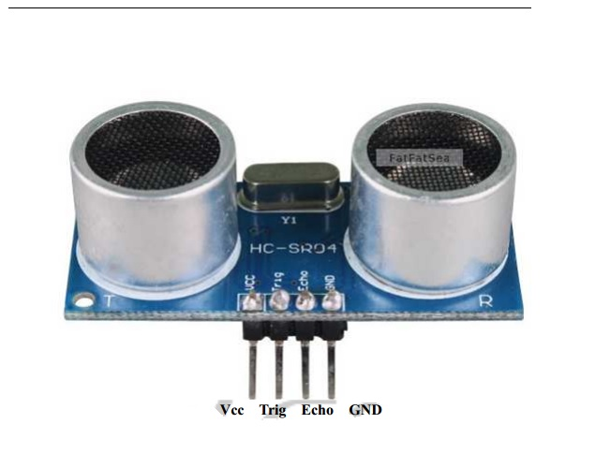
SENSORS SPECIFICATIONS
Ultrasonic Level Sensors
Name:HC-SR04
Detection Distance:2cm-400cm
Voltage:5VDC
High precision:up to 0.3cm
Principle:”Time of Flight”

Slide 18
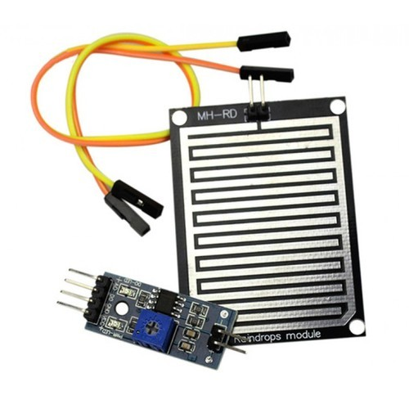
Rain Drop Sensors
Name :MH-RD(Maker &Hacker)
Voltage:5V
Principle:”Current in the nickel
coated plate”

Slide 19
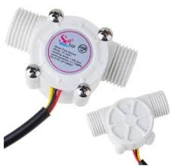
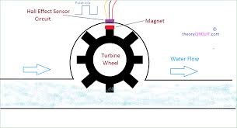
Water Flow Sensor
Name:YF-S201
Working range:1-30L/min
Voltage:4.5V
Principle:”Hall Effect”

Slide 20
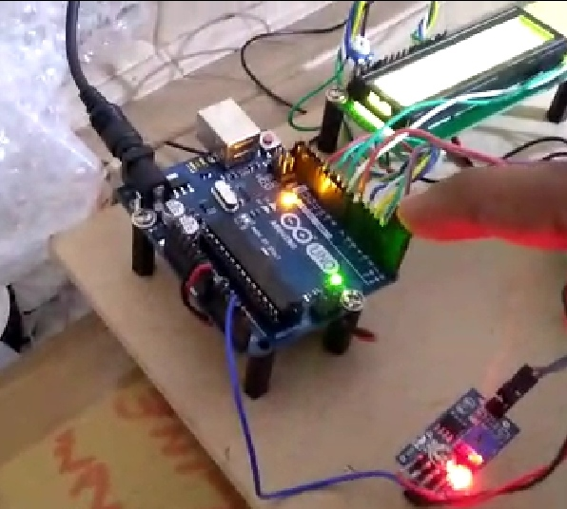
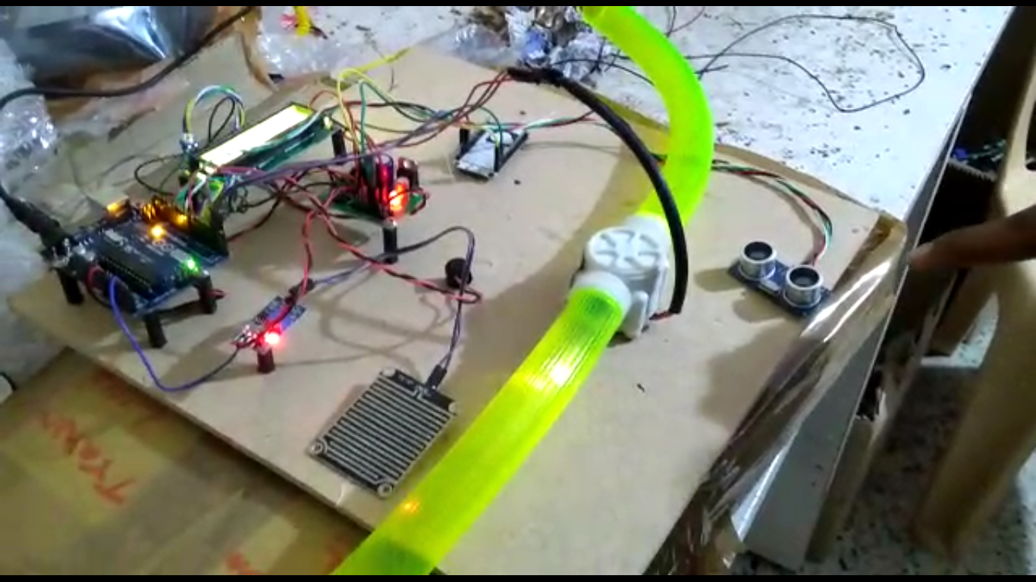
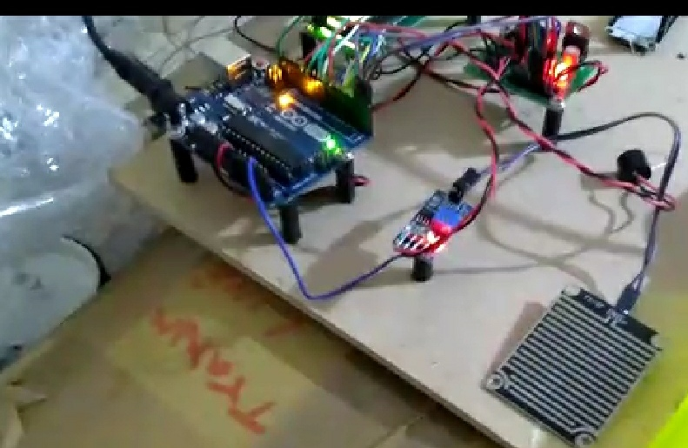
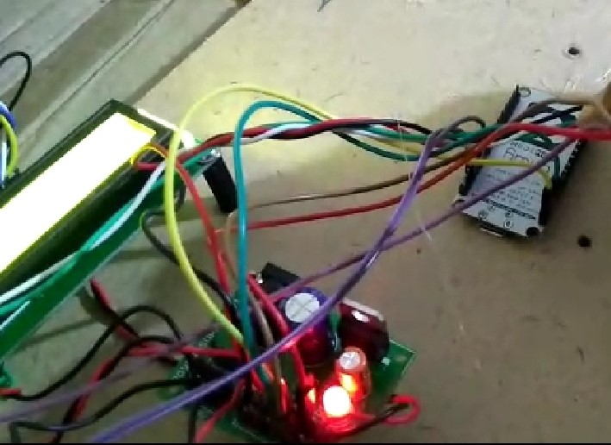
TESTING OF PROPOSED SYSTEM
Dept of ECE, KSSEM
20

Slide 21
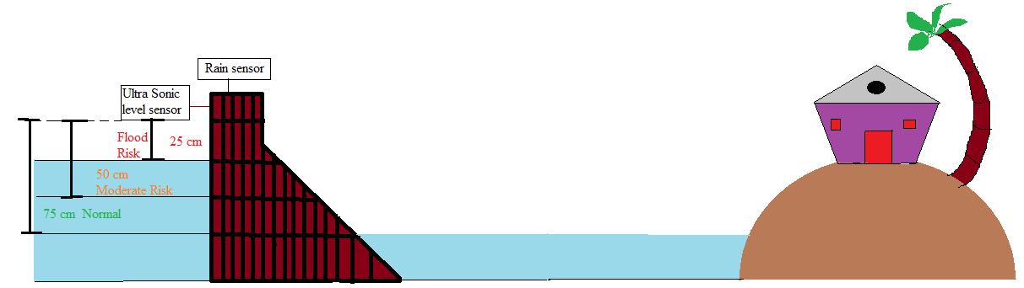
IMPLEMENTATION(Pictorial Representation)
Dept of ECE, KSSEM
21

Slide 22
Proposed System Advantages
As a precaution using this we can save lives.
We can reduce losses and damages to the properties.
We can take safety measures.
Dept of ECE, KSSEM
22

Slide 23
POSSIBLE OUTCOMES
Deploying Wireless Sensor Network For Flood Detection.
Dept of ECE, KSSEM
23

Slide 24
CONCLUSION
By use of Wireless Sensor Network any mechanical or geo-physical sensor can be interfaced easily for protection of our on livelihood as well as nation’s wealth.
The WSN deployment leads to access many of the sensor information and by using Ethernet, Wi-Fi, Satellite or any other wireless protocol the danger intimation can be passed to the nearby villages and to the government officials.
Dept of ECE, KSSEM
24

Slide 25
References
Mustafa Mousa, Christian Claudel, “Poster Abstract: Water Level Estimation inUrban Ultrasonic/PassiveInfraredFlashFloodSensorNetworksUsingSupervisedLearning”,IEEE2014
Cholatip Yawut+ and Sathapath Kilaso, ”A Wireless Sensor Network for Weather and Disaster Alarm Systems”, 2011 International Conference on Information and Electronics Engineering IPCSIT vol.6 (2011) © (2011) IACSIT Press,Singapore
Saysoth Keoduangsine and Robert Goodwin, ”An Appropriate Flood Warning System intheContextofDevelopingCountries”,InternationalJournalofInnovation,Management and Technology, Vol. 3, No. 3, June2012
Maneesha V. Ramesh, Sangeeth Kumar, and P. Venkat Rangan,” Wireless Sensor Network for Landslide Detection”
Dept of ECE, KSSEM
25

Slide 26
.
ZHAO CHENG and WENDI B. HEINZELMAN, ” Flooding Strategy for Target Discovery in Wireless Networks”, Wireless Networks 11, 607–618,2005SpringerScience+BusinessMedia,Inc.ManufacturedinTheNetherlands.
“Flood Risk Management and Mitigation in Mekong River Basin”, 8th Annual Mekong Flood Forum 2010, viewed on 12 Nov2011.
E. Basha, et al “Design of early warning flood detection system for developing countries,”inProc.oftheConferenceonInformationandCommunicationTechnologyand Development, Dec2007.
M. Cioca, et al,”SMS Disaster Alert System Programming,”in Proc. of International Conference on Digital Ecosystem and Technologies,2008.
Dept of ECE, KSSEM
26

Slide 27
Thank You!!!

